Slide 1
Cryptography (2021S) Lecture 24
LiangFeng Zhang
zhanglf@shanghaitech.edu.cn
SIST, ShanghaiTech

Slide 2
Cryptocurrency and Blockchain
Fiat currency:
Central banks control the money supply
Add anti-counterfeiting features to physical currency
Technological: raise the bar for an attacker
Law enforcement: stop people from breaking the rules of the system.
Problems in currency: supply and prevent cheating
Cryptocurrency: Bitcoin, Ether, …
prevent people from tampering with the state of the system and from equivocating (e.g., double spending)
the security rules need to be enforced purely technologically and without relying on a central authority
Blockchain: The underlying data structure of a cryptocurrency.
Build with hash pointers

Slide 3
Hash Pointer
Hash pointer: A pointer to where some information is stored together with a cryptographic hash of the information
Regular pointer: allows you to retrieve info.
Hash pointer: retrieve info. + verify that the info. hasn’t been changed
Application: build all kinds of data structures
Data structures that use pointers: a linked list or a binary search tree
Implement it with hash pointers instead of ordinary pointers

Slide 4
Blockchain
Blockchain: A linked list using hash pointers.
Regular linked list: a series of blocks; each block=data+ a pointer to the previous block in the list
Blockchain: the pointer will be replaced with a hash pointer.
The pointer tells us where the previous block was
It also contains a digest of that block’s value
allows us to verify that the value hasn’t been changed

Slide 5
Application of Blockchain
Tamper-evident log: a log data structure that stores data and allows us to append data to the end of the log
if somebody alters an earlier item in the log, we can detect the change.
The adversary cannot tamper with the head of the list.
genesis block: the first block on the chain

Slide 6
Merkle Tree
Merkle Tree: A binary tree with hash pointers
Building a Merkle tree in the following way:
Leaves of the tree: blocks containing data
Group the data items into pairs of two
For each pair we build a data structure that has two hash pointers
Group the hash pointers into groups of two,
Compute the hash of each pair
Continue doing this until we reach a single block
Merkle root: the root of the tree
The data items
in Bitcoin are
transactions.

Slide 7
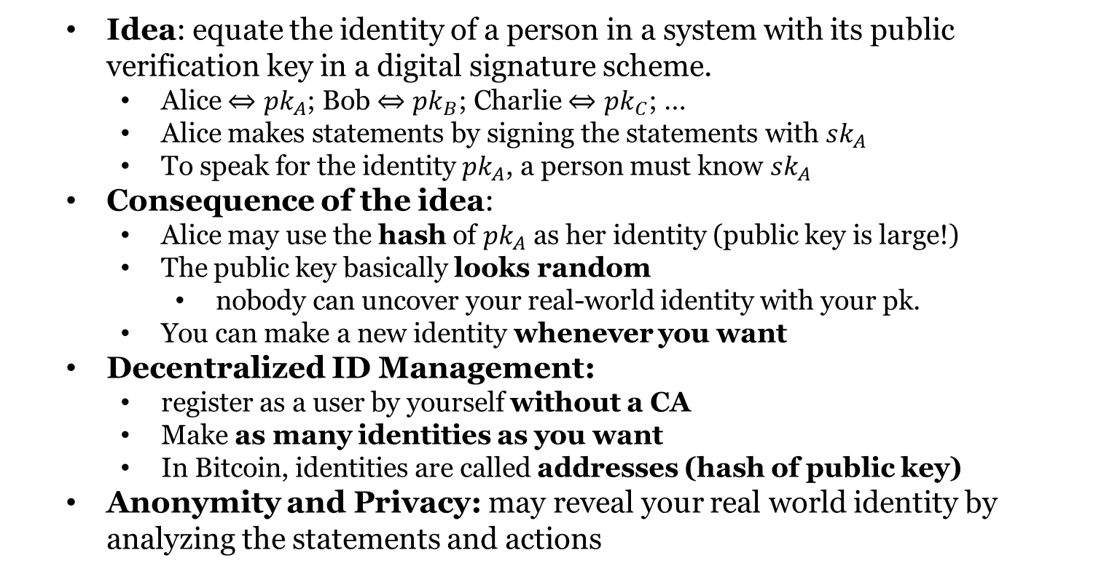
Public Key as Identities
Idea: equate the identity of a person in a system with its public verification key in a digital signature scheme.
Alice $⇔pk_{A}$; Bob $⇔pk_{B}$; Charlie $⇔pk_{C}$; …
Alice makes statements by signing the statements with $sk_{A}$
To speak for the identity $pk_{A}$, a person must know $sk_{A}$
Consequence of the idea:
Alice may use the hash of $pk_{A}$ as her identity (public key is large!)
The public key basically looks random
nobody can uncover your real-world identity with your pk.
You can make a new identity whenever you want
Decentralized ID Management:
register as a user by yourself without a CA
Make as many identities as you want
In Bitcoin, identities are called addresses (hash of public key)
Anonymity and Privacy: may reveal your real world identity by analyzing the statements and actions

Slide 8
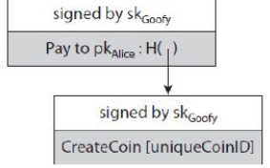
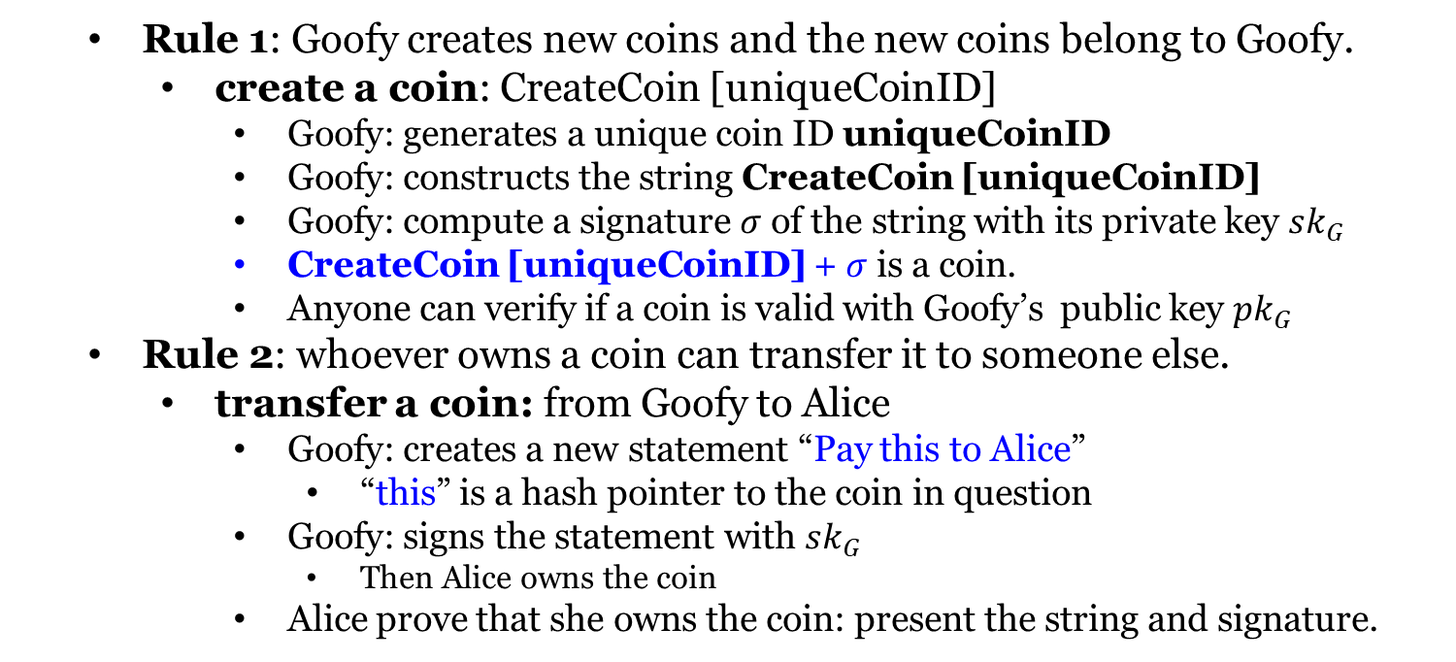
Goofycoin
Rule 1: Goofy creates new coins and the new coins belong to Goofy.
create a coin: CreateCoin [uniqueCoinID]
Goofy: generates a unique coin ID uniqueCoinID
Goofy: constructs the string CreateCoin [uniqueCoinID]
Goofy: compute a signature $σ$ of the string with its private key $sk_{G}$
CreateCoin [uniqueCoinID] + $σ$ is a coin.
Anyone can verify if a coin is valid with Goofy’s public key $pk_{G}$
Rule 2: whoever owns a coin can transfer it to someone else.
transfer a coin: from Goofy to Alice
Goofy: creates a new statement “Pay this to Alice”
“this” is a hash pointer to the coin in question
Goofy: signs the statement with $sk_{G}$
Then Alice owns the coin
Alice prove that she owns the coin: present the string and signature.

Slide 9
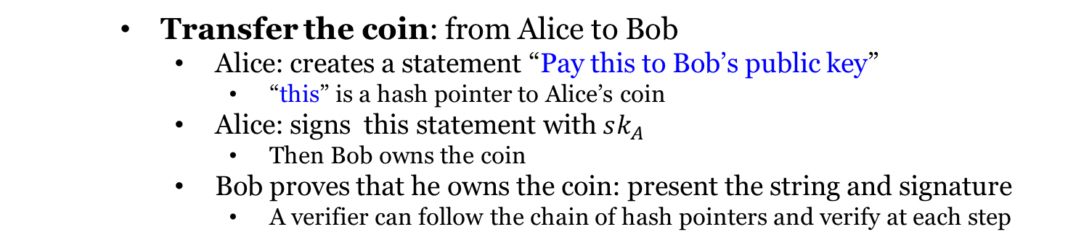
Goofycoin
Transfer the coin: from Alice to Bob
Alice: creates a statement “Pay this to Bob’s public key”
“this” is a hash pointer to Alice’s coin
Alice: signs this statement with $sk_{A}$
Then Bob owns the coin
Bob proves that he owns the coin: present the string and signature
A verifier can follow the chain of hash pointers and verify at each step

Slide 10
Goofycoin
Double-spending attack: Spend the same coin twice
Alice transfer her coin by sending her signed statement to Bob
Alice didn’t tell anyone else about this transfer
Alice sends a signed statement that pays the same coin to Charlie.
Bob and Charlie both claim to be the owner of that coin.
Double-spending attack is one of the key problems that any cryptocurrency has to solve.

Slide 11
Scroogecoin
Scrooge publishes an append-only ledger containing all TX history
Any data written to this ledger will remain forever in the ledger
A TX must be written in the ledger before it is accepted
The history of coins will be publicly documented
Each block: ID of TX, TX contents, a hash pointer to the previous block
A TX counts iff it is in the block chain signed by Scrooge.
Scrooge doesn’t endorse a TX that double spends a coin.
A TX is endorsed by Scrooge? Checking signature

Slide 12
Scroogecoin
In Scroogecoin, there are two kinds of transactions.
CreateCoins: valid if it is signed by Scrooge
PayCoins: Consumes coins; creates new coins of same total value
The PayCoins TX is valid iff
The consumed coins are valid (created in previous TXs)
The consumed coins have not already been consumed earlier
Out coins = in coins
It is validly signed by the owners of all consumed coins

Slide 13
Scroogecoin
If PayCoins transaction is valid
Scrooge will accept it
Scrooge write it into the ledger by appending it to the blockchain
everyone can see that this TX has happened.
Prevent double spending: People can determine if
the coins are valid
all TXs are valid
every coin is spent only once
The centralization in Scroogecoin:
Scrooge stop endorsing TXs from some users?
coins become unspendable
cryptocurrencies with a CA largely failed to take off in practice
Get rid of Scrooge? Need Distributed Consensus
users can agree on a single published blockchain as the TX history
users can agree on which TXs are valid, have actually occurred
users need to be able to assign IDs in a decentralized way
the minting of new coins needs to be decentralized

Slide 14
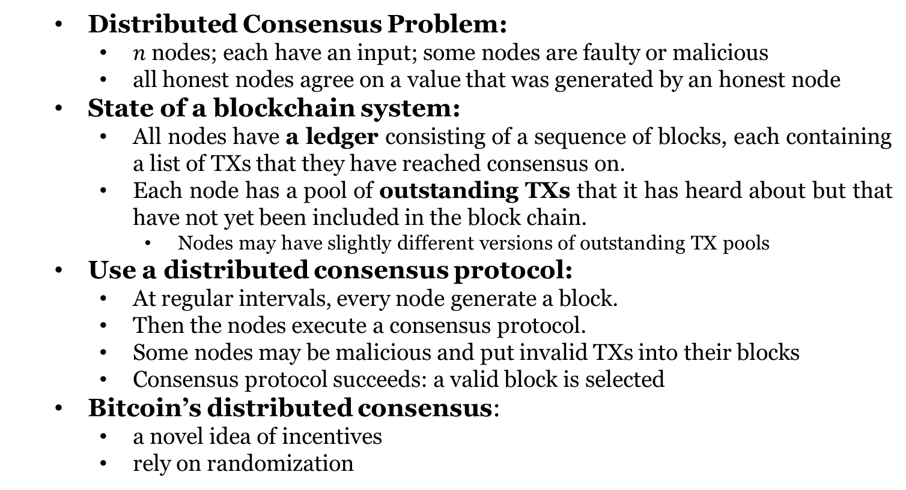
Distributed Consensus
Distributed Consensus Problem:
$n$ nodes; each have an input; some nodes are faulty or malicious
all honest nodes agree on a value that was generated by an honest node
State of a blockchain system:
All nodes have a ledger consisting of a sequence of blocks, each containing a list of TXs that they have reached consensus on.
Each node has a pool of outstanding TXs that it has heard about but that have not yet been included in the block chain.
Nodes may have slightly different versions of outstanding TX pools
Use a distributed consensus protocol:
At regular intervals, every node generate a block.
Then the nodes execute a consensus protocol.
Some nodes may be malicious and put invalid TXs into their blocks
Consensus protocol succeeds: a valid block is selected
Bitcoin’s distributed consensus:
a novel idea of incentives
rely on randomization

Slide 15
Idea of Bitcoin Consensus
Bitcoin: nodes do not have persistent, long-term identities; no CA
Sybil attack: An adversary controls many copies of nodes
Assumptions:
It is possible to pick a random node from the Bitcoin network
The Sybils obtain only 1 token.
Bitcoin’s consensus: under the two assumptions,
New TXs are broadcast to all nodes.
Each node collects new TXs into a block.
In each round, a random node gets to broadcast its block.
The block is accepted iff all TXs in it are valid (unspent, valid signatures).
Nodes accept the block by including its hash in the next block they create.

Slide 16
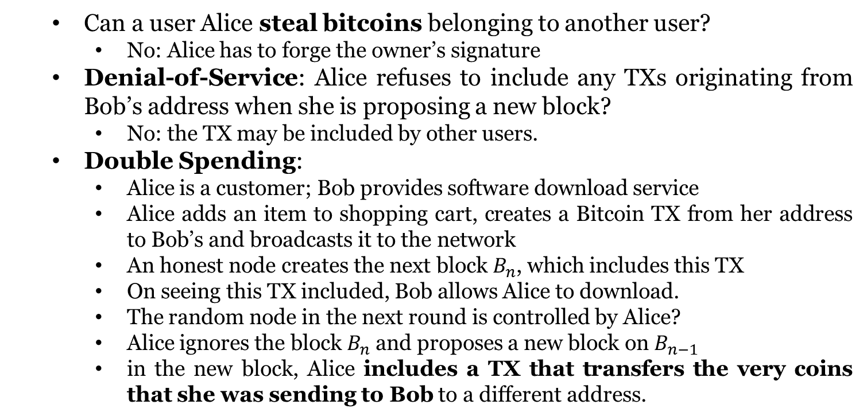
Possible Attacks
Can a user Alice steal bitcoins belonging to another user?
No: Alice has to forge the owner’s signature
Denial-of-Service: Alice refuses to include any TXs originating from Bob’s address when she is proposing a new block?
No: the TX may be included by other users.
Double Spending:
Alice is a customer; Bob provides software download service
Alice adds an item to shopping cart, creates a Bitcoin TX from her address to Bob’s and broadcasts it to the network
An honest node creates the next block $B_{n}$, which includes this TX
On seeing this TX included, Bob allows Alice to download.
The random node in the next round is controlled by Alice?
Alice ignores the block $B_{n}$ and proposes a new block on $B_{n−1}$
in the new block, Alice includes a TX that transfers the very coins that she was sending to Bob to a different address.

Slide 17
Possible Attacks
Heuristic: extend the block that they 1st detected on the P2P network
Due to network latency, the block containing double spending TX may be heard first; Nodes may extend this block;
If the next node builds on the double-spend block, then this chain will now be longer than the one that includes the transaction to Bob.

Slide 18
Possible Attacks
Seeing 0 confirmation, Bob allows Alice to download the software?
Alice can immediately broadcast a double-spend TX
A node may include it in the next block instead of the TX that pays Bob.
Idea: continue to wait even after the TX was included in a block
Alice double-spend attack? Bob Refuse; Alice → Bob TX included? Good!
More confirmations-> higher probability of survival
Reason: heuristic; In Bitcoin, wait for 6 confirmations
Trade-off: time you have to wait; guarantee of survival

Slide 19
Incentive-Based Protections in Bitcoin
Protection against invalid TXs is cryptographic.
enforced by consensus: if a node does attempt to include a crypto invalid TX, then the only reason that TX won’t survive is because a majority of the nodes are honest and won’t include an invalid TX in the blockchain.
Protection against double spending is by consensus.
consensus determines valid TX/double spend TX will survive
Why will the nodes perform honestly?
Reward the nodes that created blocks that eventually survive
Block Reward: The proposer of a block can include a special TX
This TX is a coin-creation TX, analogous to CreateCoins in Scroogecoin,
The node can choose the recipient address of this TX
As of 2015, 25 bitcoins; halves with every 210000 blocks (4 yrs) created
The only way in which new bitcoins can be created
Transaction Fees: sum of TX inputs – sum of TX outputs
creator of any TX: sum of TX outputs < sum of TX inputs
If you put the TX into a block, you collect the difference

Slide 20
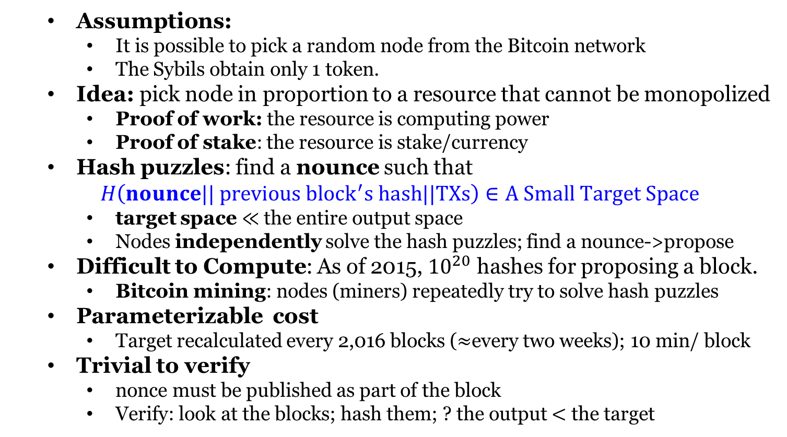
Proof of Work (PoW)
Assumptions:
It is possible to pick a random node from the Bitcoin network
The Sybils obtain only 1 token.
Idea: pick node in proportion to a resource that cannot be monopolized
Proof of work: the resource is computing power
Proof of stake: the resource is stake/currency
Hash puzzles: find a nounce such that
$H\left(nounce|| previous {block}^{′}s hash||TXs\right)∈A Small Target Space$
target space $≪$ the entire output space
Nodes independently solve the hash puzzles; find a nounce->propose
Difficult to Compute: As of 2015, ${10}^{20}$ hashes for proposing a block.
Bitcoin mining: nodes (miners) repeatedly try to solve hash puzzles
Parameterizable cost
Target recalculated every 2,016 blocks ($≈$every two weeks); 10 min/ block
Trivial to verify
nonce must be published as part of the block
Verify: look at the blocks; hash them; ? the output $<$ the target

Slide 21
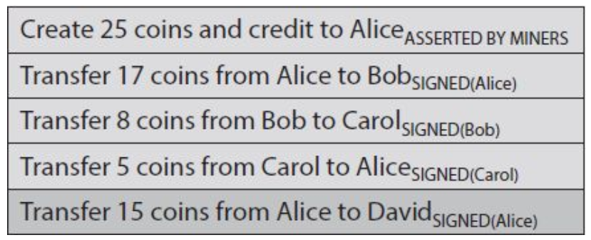
Account-Based Ledger
A TX is like “move 17 coins from Alice to Bob” and signed by Alice
determine is a TX is valid? keep track of these account balances
Account-Based Ledger

Slide 22
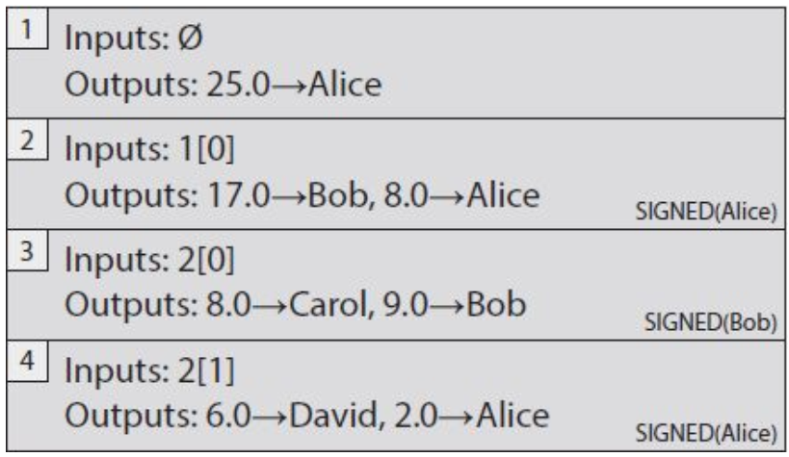
Transaction-Based Ledger
TXs specify a number of inputs and a number of outputs
Unique TX ID; Inputs: coins being spent; Outputs: coins being created
TX-Based Ledger
TX1: new coins are created; No inputs, no signature
TX2: Spend the output 0 of the TX 1; Send 17 to Bob and 8 to Alice
change address: Alice needs a new address for the 8 coins
Verification: the input has 25 bitcoins; hasn’t been spent

Slide 23
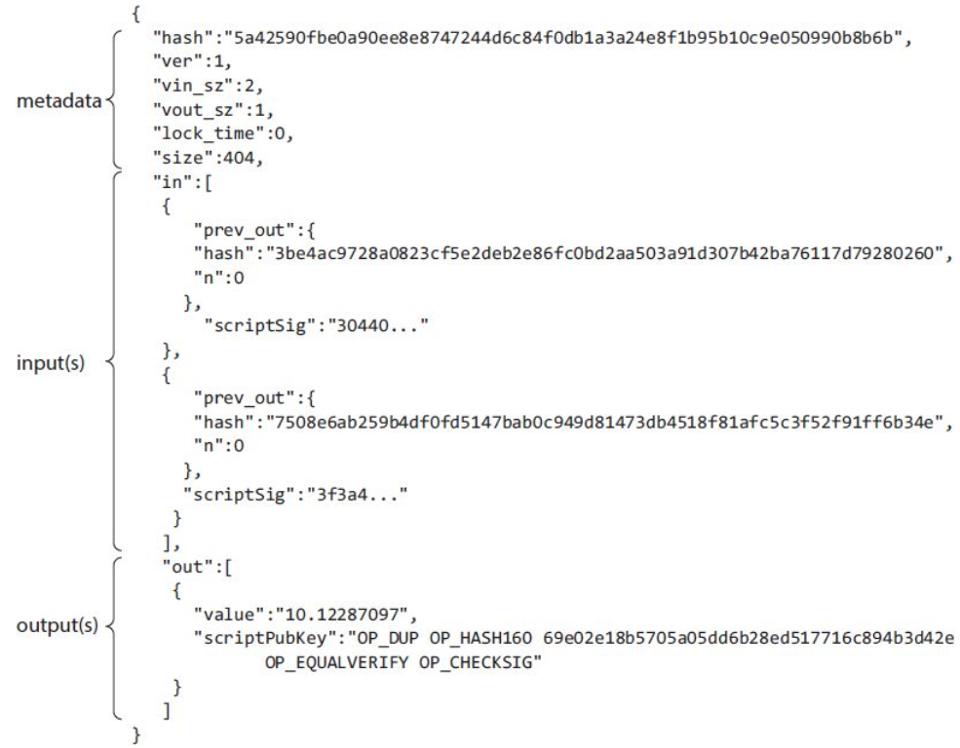
Transaction Syntax

Slide 24
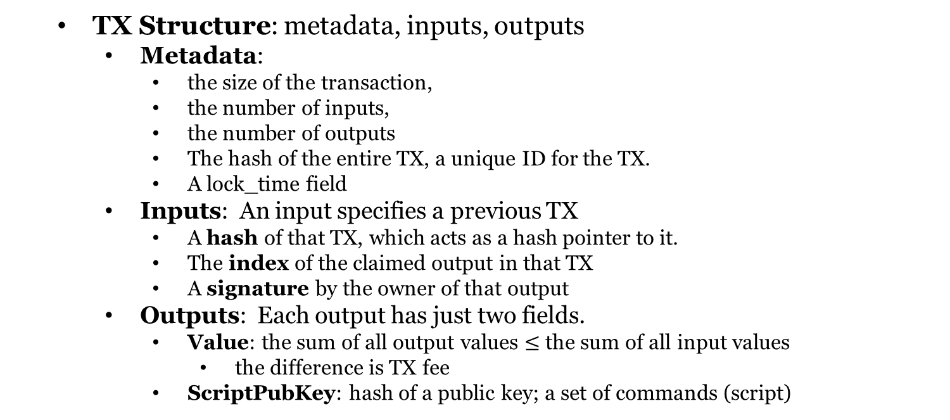
Transaction Syntax
TX Structure: metadata, inputs, outputs
Metadata:
the size of the transaction,
the number of inputs,
the number of outputs
The hash of the entire TX, a unique ID for the TX.
A lock_time field
Inputs: An input specifies a previous TX
A hash of that TX, which acts as a hash pointer to it.
The index of the claimed output in that TX
A signature by the owner of that output
Outputs: Each output has just two fields.
Value: the sum of all output values $≤$ the sum of all input values
the difference is TX fee
ScriptPubKey: hash of a public key; a set of commands (script)

Slide 25
Coinbase Transaction
New coins are created in Bitcoin with this transaction.
single input, single output.
The input contains a null hash pointer
The value of the output is currently (2015) around 25 BTC.
a flat mining reward: set by the system; halves every 210,000 blocks
the TX fees: collected from every TX included in the block.
coinbase parameter: completely arbitrary

Slide 26
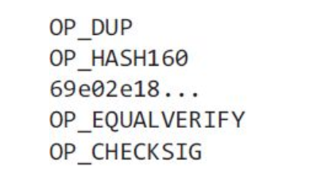
Bitcoin Scripting Language
The most common type of TX in Bitcoin: redeem a previous TX output by signing with the correct key
“this can be redeemed by a public key that hashes to X, along with a signature from the owner of that public key”
Pay-to-PubkeyHash script

Slide 27
Bitcoin Scripting Language
What happens to this script?
The inputs contain scripts instead of signatures.
Combine the new TX’s input script and the earlier TX’s output script
The resulting script must run successfully for the TX to be valid
These two scripts are scriptSig and scriptPubKey
scriptSig + scriptPubKey
The scripting language is stack-based: instruction executed linearly

Slide 28
Executing a Script
We need a stack that we can push data to and pop data from.
Two types of instructions: data instructions and opcodes.
data instruction: push data onto the top of the stack.
Opcodes: perform some function with input data on top of the stack
Execution of a Bitcoin Script
The first two instructions in this script are data instructions
OP_DUP: push a copy of the public key onto the top of the stack
OP_HASH160: pop value, compute hash, push the result

Slide 29
Bitcoin Blocks
Reach consensus on each TX? The rate is too low.
A hash chain of blocks is much shorter than a hash chain of TXs
a large number of TXs can be put into each block.
Blockchain is a combination of two hash-based data structures.
hash chain of blocks: Each block has a block header, a hash pointer to some TX data, and a hash pointer to the previous block
The header contains information related to the mining puzzle
the hash of the header of a valid block has to start with a large number of zeros
the header also contains: a nonce, a timestamp, and bits
only the header is hashed during mining
to verify a chain of blocks, all we need to do is look at the headers
Merkle tree: a per-block tree of all TXs included in that block
the root of the tree is the only TX data included in a block header

Slide 30
Bitcoin Blocks

